Slide 1
SSE & AVX
System Programming Laboratory · SSE / AVX in assembly
1 / 37

Slide 2

Foundations & scalar
The register model, how to read the instructions, and how to call libc from assembly — then three single-lane programs.
System Programming Laboratory · SSE / AVX in assembly
3 / 37

Slide 3

FOUNDATION · A SHORT HISTORY
SSE and AVX through the years
Each generation widened the registers or added instructions — and stayed backward-compatible.
1999
2004
2007–08
2013
SSE
SSE3
SSE4
AVX2 + FMA
128-bit xmm · floats
horizontal math
.1 + .2: dot-product, strings
256-bit integer · fused mul-add
2001
2006
2011
2016–17
SSE2
SSSE3
AVX
AVX-512
+ doubles, integers
shuffles, bytes
256-bit ymm · VEX · 3-operand
512-bit zmm · EVEX · 32 regs · masks
SSE era — 128-bit
AVX era — 256 → 512-bit
System Programming Laboratory · SSE / AVX in assembly
5 / 38

Slide 4


FOUNDATION · THE REGISTERS
The vector register file: xmm ⊂ ymm ⊂ zmm
zmm (512-bit)
ymm (256-bit)
xmm (128-bit)
bit 0
127
255
511
Nested, low bits first
Lanes — how many fit
SSE gave 128-bit xmm0..15; AVX widened them to 256-bit ymm; AVX-512 to 512-bit zmm. Each lives in the low bits of the next. A write through a v-prefixed (AVX) instruction zeroes the unused upper bits.
Each register is a row of independent slots called lanes (נתיב). A float is 32 bits, a double 64. So: xmm = 4 floats / 2 doubles · ymm = 8 / 4 · zmm = 16 / 8.
System Programming Laboratory · SSE / AVX in assembly
4 / 37

Slide 5

FOUNDATION · READING THE NAMES
Decode a mnemonic in four parts
Once you can read the name, the base instruction set is systematic. Read it left to right:
[ v ]
op
{ s | p }
{ s | d }
optional AVX / VEX prefix — wider regs, 3-operand form
the operation: add · sub · mul · div · sqrt · max · mov
scalar — one lane · packed — every lane
single-precision (float) · double-precision
The v prefix
SSE (no prefix, 128-bit)
AVX (v…, 128/256-bit)
decodes as
addps and vaddps decode to the SAME operation — add · packed · single. The v selects the AVX encoding (3-operand form, optional 256-bit ymm). Drop the v and you have the SSE instruction.
The difference between SSE and AVX ops on xmm is whether or not we clear out the upper 128-bit of ymm
addss
vaddss
add · scalar · single
addps
vaddps
add · packed · single
mulpd
vmulpd
mul · packed · double
sqrtss
vsqrtss
sqrt · scalar · single
maxps
vmaxps
max · packed · single
System Programming Laboratory · SSE / AVX in assembly
5 / 37

Slide 6

FOUNDATION · NO C — CALL LIBC DIRECTLY
The floating-point ABI (System V AMD64)
arguments
first 8 float/double args → xmm0 … xmm7
calling printf from assembly
; the shape of every printf call we make
extern printf
; ... compute a float result in xmm0 ...
cvtss2sd xmm0, xmm0 ; float -> double for %f
lea rdi, [rel fmt] ; "= %f\n"
mov eax, 1 ; AL = # vector regs used
call printf wrt ..plt ; external call via PLT
; three rules to get this right:
; 1) AL = number of xmm args (0 if none)
; 2) rsp 16-byte aligned at the call
; 3) widen float->double for %f
return
float/double result → xmm0
caller-saved
any call may clobber every xmm — save what you need
RIP-relative data
[rel fmt] addresses the string as a signed 32-bit offset from RIP — not an absolute address. That is what makes the program position-independent under default gcc.
System Programming Laboratory · SSE / AVX in assembly
6 / 37

Slide 7



FOUNDATION · THE THREE RULES
Why a printf call needs this setup
1 · The AL convention
2 · Stack alignment
3 · float vs double
printf is variadic. For a variadic call, AL holds how many xmm registers carry arguments. Printing one float → mov eax, 1. Strings/ints only → xor eax, eax.
rsp must be 16-byte aligned at the call instruction. The prologue push rbp / mov rbp,rsp / and rsp,-16 guarantees it.
%f prints a double. In C, a float argument is auto-promoted to double for you. In asm there is no compiler — you widen it yourself with cvtss2sd.
Why call printf wrt ..plt?
We go through the PLT (Procedure Linkage Table) so the program works as position-independent code
System Programming Laboratory · SSE / AVX in assembly
7 / 37

Slide 8

PROGRAM 1 · CPUID.ASM
Detecting features with one instruction
How cpuid works
cpuid.asm — gather words, then test bits
Put a leaf number in EAX, run cpuid, and the CPU writes feature bits into EAX/EBX/ECX/EDX. One bit per feature.
mov eax, 1
cpuid ; -> EDX, ECX feature words
mov [edx1], edx ; stash before they're lost
mov [ecx1], ecx
mov eax, 7
xor ecx, ecx ; sub-leaf 0 (required)
cpuid ; -> EBX (AVX2 = bit 5)
; test one bit: shift down, mask 1
mov eax, [ecx1]
shr eax, 28 ; AVX is ECX bit 28
and eax, 1 ; -> 0 or 1
leaf 1 → EDX[25]=SSE EDX[26]=SSE2
leaf 1 → ECX[28]=AVX ECX[12]=FMA
leaf 7 → EBX[5]=AVX2 EBX[16]=AVX-512F
cpuid clobbers all four GP registers — so we save the words to memory, then test bits.
System Programming Laboratory · SSE / AVX in assembly
8 / 37

Slide 9
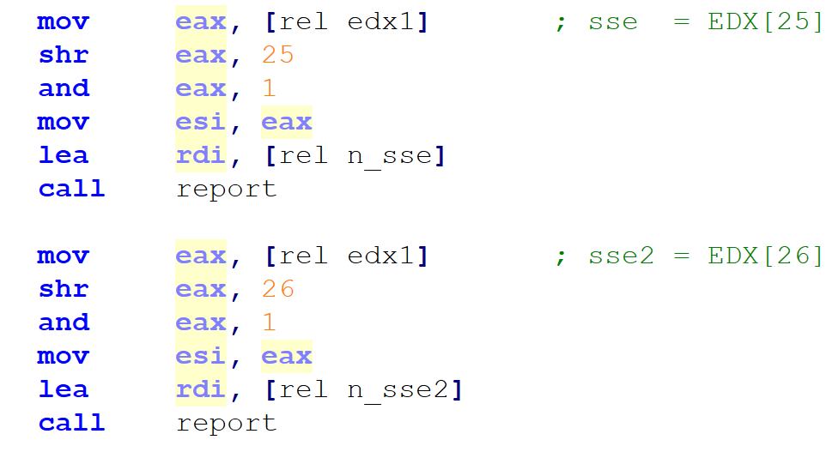
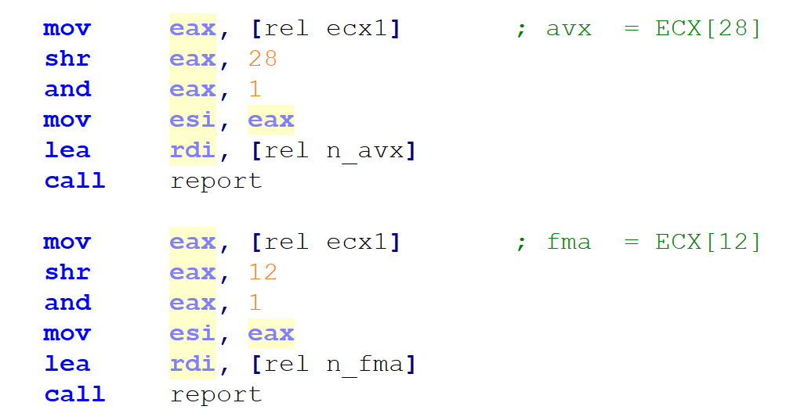
System Programming Laboratory · SSE / AVX in assembly
9 / 37

Slide 10

PROGRAM 1 · CPUID.ASM — RUN IT
shell
# build just this one
nasm -f elf64 cpuid.asm -o cpuid.o
gcc cpuid.o -o cpuid
./cpuid
output
$ ./cpuid
SIMD support (read straight from CPUID):
sse : yes
sse2 : yes
avx : yes
fma : yes
avx2 : yes
avx512f : no
System Programming Laboratory · SSE / AVX in assembly
9 / 37

Slide 11

PROGRAM 1 · DEBUGGING
build with debug info (-g -F dwarf)
nasm -f elf64 -g -F dwarf cpuid.asm \
-o cpuid.o
gcc -g -o cpuid cpuid.o
gdb session — watch the registers change
One command debugging option
break dbg_cpuid ; after leaf-1 cpuid
run
info registers eax ebx ecx edx
print/t $ecx ; binary: bit28=AVX bit12=FMA
print/t $edx ; binary: bit25=SSE bit26=SSE2
display/t $eax ; sticky binary view
stepi ; watch the words get saved
continue
make inspect PROG=cpuid
builds this program with debug info and runs its gdb script automatically — every command on the left, no typing.
System Programming Laboratory · SSE / AVX in assembly
10 / 37

Slide 12
PROGRAM 2 · SCALAR_SSE.ASM
Scalar ops
scalar_sse.asm — three single-lane routines
Scalar = lane 0 only
section .rodata
one_f: dd 1.0
c41: dd 41.0
c3: dd 3.0
c7: dd 7.0
section .text
addone_f:
addss xmm0, [rel one_f] ; xmm0[0] += 1.0f
ret ; result stays in xmm0 (ABI)
fmax2_f:
maxss xmm0, xmm1 ; max(a, b), lane 0
ret
fsqrt_f:
sqrtss xmm0, xmm0 ; sqrt(x), lane 0
ret
addss / maxss / sqrtss each touch only lane 0 of the xmm register; the other lanes are left alone. Inputs arrive in xmm0 (and xmm1); the result stays in xmm0 — exactly the ABI.
System Programming Laboratory · SSE / AVX in assembly
11 / 37

Slide 13
PROGRAM 2 · SCALAR_SSE.ASM — DRIVER & OUTPUT
scalar_sse.asm — main + the print helper
output
main:
movss xmm0, [rel c41] ; load 41.0f
call addone_f ; -> 42.0f
lea rdi, [rel s_add]
call print_f
movss xmm0, [rel c3] ; a = 3
movss xmm1, [rel c7] ; b = 7
call fmax2_f ; -> 7.0f
...
print_f:
cvtss2sd xmm0, xmm0 ; widen for %f
mov eax, 1 ; AL = 1 xmm arg
call printf wrt ..plt
$ ./scalar_sse
addss 41.0+1.0 = 42.000000
maxss max(3,7) = 7.000000
sqrtss sqrt(2.0) = 1.414214
The hidden conversion
Each result is a 32-bit float, but %f reads a 64-bit double. cvtss2sd does the widening the C compiler would have inserted for you.
System Programming Laboratory · SSE / AVX in assembly
12 / 37

Slide 14
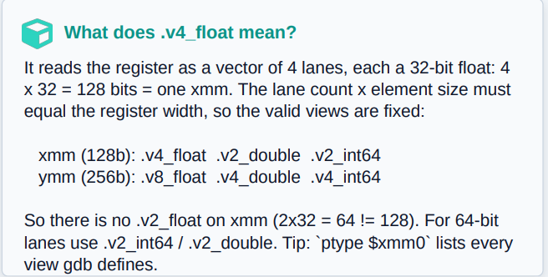
PROGRAM 2 · DEBUGGING
build with debug info (-g -F dwarf)
What to watch
nasm -f elf64 -g -F dwarf \
scalar_sse.asm -o scalar_sse.o
gcc -g -o scalar_sse scalar_sse.o
Scalar ops touch only lane 0. The .v4_float view shows all four lanes, so you can see that addss / maxss / sqrtss change lane 0 and leave the rest untouched. display re-prints the register after every stepi, so the change is obvious.
gdb session — watch the registers change
break dbg_scalar ; inside addone_f
run
print $xmm0.v4_float ; {41,0,0,0}
display $xmm0.v4_float ; sticky
stepi ; run the addss
print $xmm0.v4_float ; {42,0,0,0}
break fmax2_f ; next routine
continue
info registers xmm0 xmm1
System Programming Laboratory · SSE / AVX in assembly
13 / 37

Slide 15
NAMING · BEYOND THE BASE PATTERN (1/2)
Fused multiply-add: reading vfmadd213ss
FMA names add ONE thing to the grammar: three digits that fix the operand order. Everything else is familiar.
v
fmadd
213
ss
AVX prefix
fused multiply-add
operand order
scalar · single
what 213 / 231 mean
Why FMA at all
; the digits name which operand is which:
; dst/op1 <- op? * op? + op?
vfmadd213ss op1, op2, op3
-> op1 = op2 * op1 + op3 ; the '213' order
vfmadd231ps op1, op2, op3
-> op1 = op2 * op3 + op1 ; the '231' order
One instruction does a multiply AND an add with a SINGLE instruction — faster, and more accurate than a separate mul then add.
System Programming Laboratory · SSE / AVX in assembly
14 / 37

Slide 16


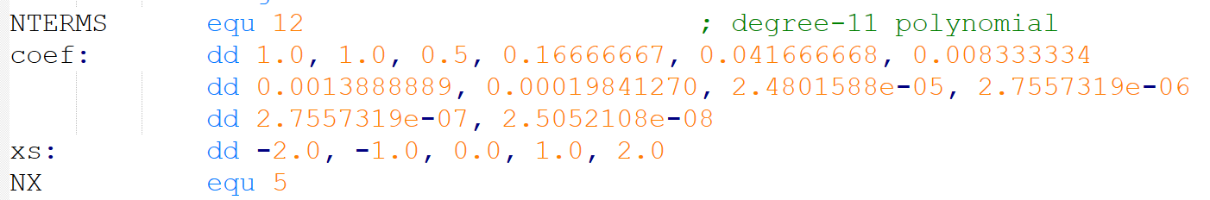
PROGRAM 3 · FMA_HORNER.ASM
A Taylor series for eˣ, evaluated by Horner's rule
Horner's rule
e^x ≈ a0 + x·(a1 + x·(a2 + …)). Where
Evaluate inside-out: start the accumulator at the top coefficient, then repeat acc ← x·acc + coef[i]. Each step is exactly one FMA (the 213 form from the previous slide).
System Programming Laboratory · SSE / AVX in assembly
15 / 37

Slide 17
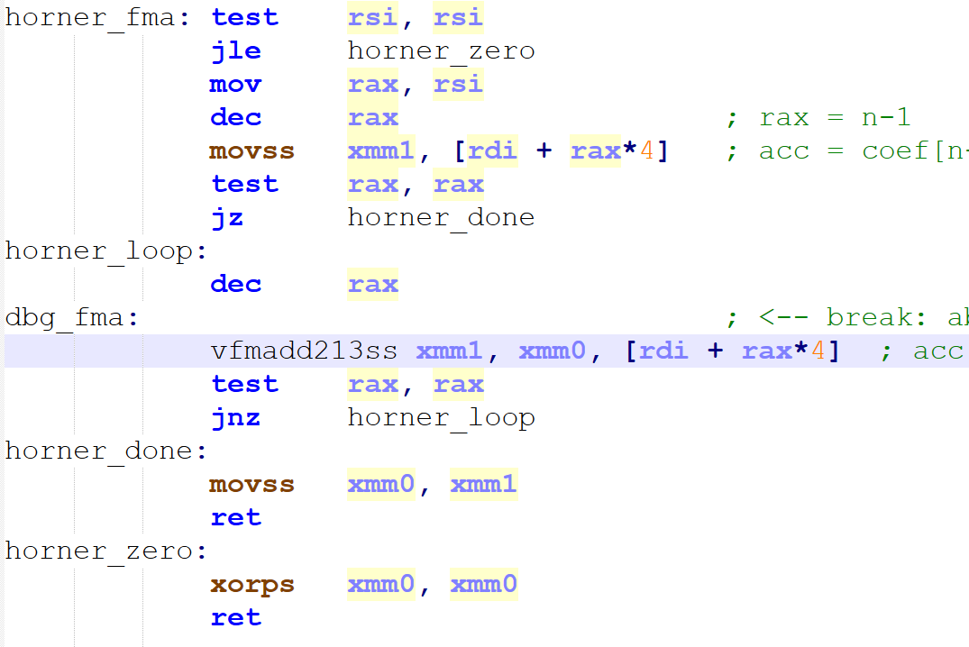
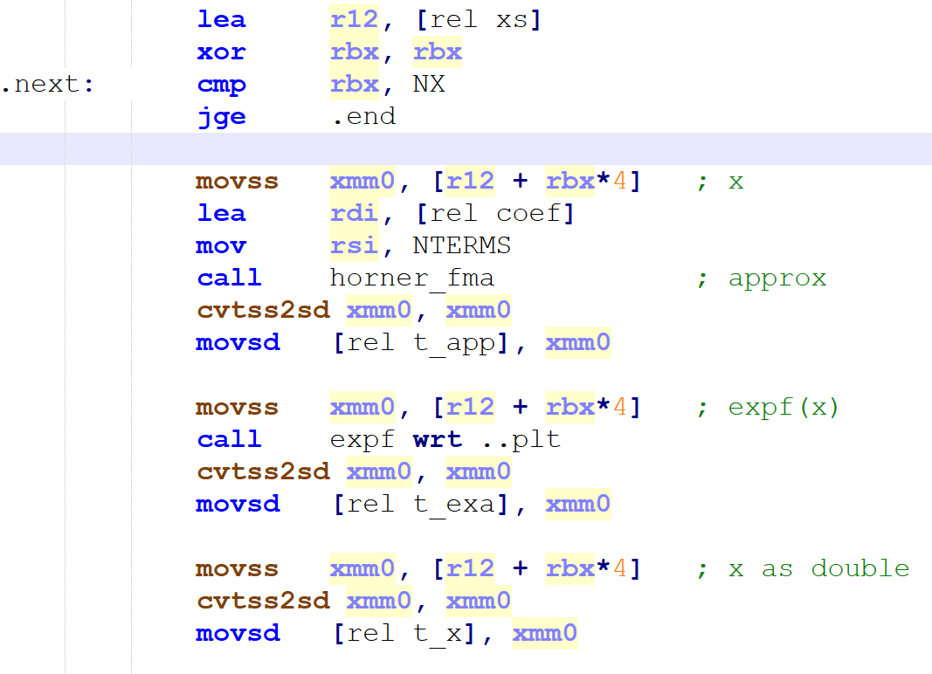
PROGRAM 3 · FMA_HORNER.ASM
A Taylor series for eˣ, evaluated by Horner's rule
System Programming Laboratory · SSE / AVX in assembly
15 / 37

Slide 18
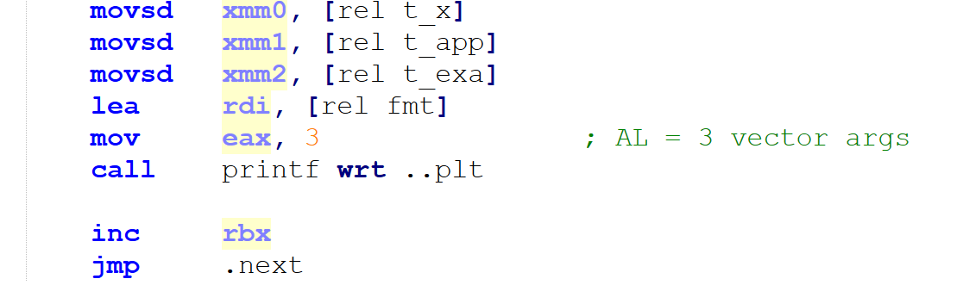
PROGRAM 3 · FMA_HORNER.ASM
Printing floating-point with xmm
System Programming Laboratory · SSE / AVX in assembly
15 / 37

Slide 19
PROGRAM 3 · FMA_HORNER.ASM — RUN IT
FMA-Horner vs the library, side by side
shell — note the -lm
Reading the result
nasm -f elf64 fma_horner.asm -o fma_horner.o
gcc fma_horner.o -o fma_horner -lm ; needs libm
./fma_horner
The two columns match to ~6 digits.
The tiny gap at x = 2.0 (…046 vs …056) is exactly the truncation error of an 11-term Taylor series — the polynomial is finite, expf is not.
output
x horner_fma expf
-2.0 0.135335 0.135335
-1.0 0.367879 0.367879
0.0 1.000000 1.000000
1.0 2.718282 2.718282
2.0 7.389046 7.389056
System Programming Laboratory · SSE / AVX in assembly
16 / 37

Slide 20
PROGRAM 3 · DEBUGGING
Watch the accumulator on each FMA step
build with debug info (-g -F dwarf)
What to watch
nasm -f elf64 -g -F dwarf \
fma_horner.asm -o fma_horner.o
gcc -g -o fma_horner fma_horner.o -lm ; needs -lm
The breakpoint sits on the FMA, so every time you continue you stop one Horner step later.
Watching xmm1 (the accumulator) lets you see the polynomial build up term by term - continue N skips N breakpoint hits — handy to jump to the next x value.
gdb session — watch the registers change
break dbg_fma ; the vfmadd213ss
run
print $xmm0.v4_float ; x
print $xmm1.v4_float ; acc before term
display $xmm1.v4_float ; sticky acc
stepi ; acc <- x*acc + coef[i]
continue ; next term (hits again)
continue 11 ; skip one whole polynomial
One command
make inspect PROG=fma_horner
builds this program with debug info and runs its gdb script automatically — every command on the left, no typing.
System Programming Laboratory · SSE / AVX in assembly
17 / 37

Slide 21
SESSION 2
Packed parallelism & inspection
One instruction over many lanes — then open the debugger and read the live register every way at once.
System Programming Laboratory · SSE / AVX in assembly
18 / 37

Slide 22
System Programming Laboratory · SSE / AVX in assembly
18 / 37

Slide 23
PROGRAM 4 · PACKED.ASM
One instruction, every lane — the vertical operation
a
1
2
3
4
The vertical loop
addps means: for all lanes i, v[i] = a[i] + b[i]. The lanes are independent, so the hardware does them simultaneously. There is no loop around the instruction itself.
b
10
20
30
40
addps
11
22
33
44
one instruction — all four lanes at once
Wider = more lanes
packed.asm — 4 lanes (xmm, 128-bit)
addps over xmm does 4. The AVX form vaddps over ymm does 8 — note its 3-operand shape: vaddps ymm0, ymm0, ymm1. Same idea, double the width.
add4_ps:
movups xmm0, [rsi] ; load a[0..3]
addps xmm0, xmm1 ; 4 adds in parallel
movups [rdi], xmm0 ; store the 4 results
System Programming Laboratory · SSE / AVX in assembly
19 / 37

Slide 24
PROGRAM 4 · PACKED.ASM — 8 LANES & OUTPUT
The same operation, doubled width
packed.asm — 8 lanes (ymm, 256-bit)
output
add8_ps:
vmovups ymm0, [rsi] ; load a[0..7]
vmovups ymm1, [rdx] ; load b[0..7]
vaddps ymm0, ymm0, ymm1 ; 8 adds at once
vmovups [rdi], ymm0
vzeroupper ; AVX hygiene before ret
ret
$ ./packed
SSE: 4 lanes (xmm, 128-bit)
a : 1 2 3 4
b : 10 20 30 40
addps : 11 22 33 44
subps : -9 -18 -27 -36
mulps : 10 40 90 160
AVX: 8 lanes (ymm, 256-bit)
vaddps : 11 22 33 44
55 66 77 88
shell
# build & run
make packed && ./packed
System Programming Laboratory · SSE / AVX in assembly
20 / 37

Slide 25
PROGRAM 4 · DEBUGGING
Watch every lane update on one instruction
build with debug info (-g -F dwarf)
What to watch
nasm -f elf64 -g -F dwarf packed.asm \
-o packed.o
gcc -g -o packed packed.o
The whole point of packed: a SINGLE stepi over addps changes all four lanes at once, and over vaddps all eight. Compare .v4_float on xmm (128-bit) with .v8_float on ymm (256-bit) — same operation, double the lanes.
gdb session — watch the registers change
break dbg_addps ; the 4-lane addps
run
print $xmm0.v4_float ; a = {1,2,3,4}
print $xmm1.v4_float ; b = {10,20,30,40}
stepi ; ONE addps -> all 4 lanes
print $xmm0.v4_float ; {11,22,33,44}
break dbg_vaddps ; the 8-lane vaddps
continue
print $ymm0.v8_float ; 8 lanes (ymm)
One command
make inspect PROG=packed
builds this program with debug info and runs its gdb script automatically — every command on the left, no typing.
System Programming Laboratory · SSE / AVX in assembly
21 / 37

Slide 26
PROGRAM 5 · DOTPROD.ASM
A reduction: packed FMA, then a cross-lane fold
Phase 1 — vertical (easy)
dotprod.asm — vertical loop + fold
Sweep 8 elements per step. One vfmadd231ps does, for all 8 lanes, acc[i] += a[i]·b[i] with one rounding. After the loop, acc holds 8 partial sums — one per lane.
.loop: ; sweep 8 floats at a time
vmovups ymm1, [rdi+rax*4]
vmovups ymm2, [rsi+rax*4]
vfmadd231ps ymm0, ymm1, ymm2 ; acc += a*b
add rax, 8
jmp .loop
.reduce: ; 8 lanes -> 1
vextractf128 xmm1, ymm0, 1
vaddps xmm0, xmm0, xmm1 ; -> 4
vhaddps xmm0, xmm0, xmm0 ; -> 2
vhaddps xmm0, xmm0, xmm0 ; -> 1
Phase 2 — the catch
A dot product is ONE number, but the sum is spread across 8 lanes. Combining lanes means moving data BETWEEN lanes — a point of synchronization. We do it once, at the very end.
System Programming Laboratory · SSE / AVX in assembly
22 / 37

Slide 27
PROGRAM 5 · DOTPROD.ASM — THE FOLD
Eight partial sums collapse to one
8 lanes (ymm)
output — both agree
$ ./dotprod
AVX+FMA (8 lanes
+ fold) = 32762.0
scalar reference = 32762.0
+ extractf128 → 4
haddps → 2
haddps → 1
Cross-lane motion happens only here — once, after the whole loop. That is what makes a reduction the interesting part of SIMD.
The cross-check
A plain one-element-at-a-time scalar loop computes the same sum. Matching values prove the packed version and its fold are correct.
System Programming Laboratory · SSE / AVX in assembly
23 / 37

Slide 28
PROGRAM 5 · DEBUGGING
Watch 8 partial sums, then the fold to 1
build with debug info (-g -F dwarf)
What to watch
nasm -f elf64 -g -F dwarf dotprod.asm \
-o dotprod.o
gcc -g -o dotprod dotprod.o
Two breakpoints tell the two-phase story. At dbg_dot_acc you see the 8 lanes accumulate. At dbg_dot_fold you step the cross-lane collapse (vextractf128, then two vhaddps) and watch the partial sums merge into a single number in lane 0.
gdb session — watch the registers change
break dbg_dot_acc ; the accumulating FMA
run
display $ymm0.v8_float ; 8 partial sums
stepi ; one FMA folds in 8 more
break dbg_dot_fold ; start of the fold
continue
print $ymm0.v8_float ; 8 partials
stepi ; watch 8 -> 4 -> 2 -> 1
print $xmm0.v4_float
One command
make inspect PROG=dotprod
builds this program with debug info and runs its gdb script automatically — every command on the left, no typing.
System Programming Laboratory · SSE / AVX in assembly
24 / 37

Slide 29
PROGRAM 6 · LOADS.ASM
Aligned vs unaligned moves
loads.asm — the only difference is aps vs ups
The a / u dimension
sum_aligned:
vmovaps ymm1, [rdi+rax*4] ; FAULTS if not 32-aligned
vaddps ymm0, ymm0, ymm1
sum_unaligned:
vmovups ymm1, [rdi+rax*4] ; works at ANY address
vaddps ymm0, ymm0, ymm1
vmovaps = ALIGNED: faults unless the address is 32-byte aligned. vmovups = UNALIGNED: never faults. On aligned data both cost the same on modern CPUs.
Rule of thumb
Prefer the unaligned form unless you specifically WANT the alignment check. The program sums the same array both ways (identical result), then does a vmovups from a deliberately misaligned address (arr+1) — where vmovaps would have crashed.
System Programming Laboratory · SSE / AVX in assembly
25 / 37

Slide 30
PROGRAM 6 · LOADS.ASM — RUN IT
Same answer; one address only one form survives
shell
What the last line proves
make loads && ./loads
arr+1 float is one float past a 32-byte boundary, so it is NOT aligned. vmovups reads it anyway and lands arr[1] = 1.0 in lane 0.
Had we used vmovaps at that same address, the program would have died with a fault (SIGSEGV) instead of printing. That single contrast is the whole lesson: unaligned is the safe default.
output
$ ./loads
Summing 4096 aligned floats, two ways:
vmovaps (aligned) = 4096.0
vmovups (unaligned) = 4096.0
vmovups from arr+1 -> lane0 = 1.0
System Programming Laboratory · SSE / AVX in assembly
26 / 37

Slide 31
PROGRAM 6 · DEBUGGING
Watch a load fill ymm1; see the misaligned case
build with debug info (-g -F dwarf)
What to watch
nasm -f elf64 -g -F dwarf loads.asm \
-o loads.o
gcc -g -o loads loads.o
Step the vmovaps and watch ymm1 fill with eight 1.0s — a load is just data moving into the register. Then the dbg_misaligned breakpoint puts you on the vmovups from arr+1: stepping it succeeds, where a vmovaps at that unaligned address would have crashed.
gdb session — watch the registers change
break dbg_aligned ; on the vmovaps
run
print $ymm1.v8_float ; stale, before load
stepi ; ALIGNED load fills ymm1
print $ymm1.v8_float ; {1,1,1,1,1,1,1,1}
break dbg_misaligned ; vmovups from arr+1
continue
stepi ; unaligned load succeeds
print $ymm0.v8_float
One command
make inspect PROG=loads
builds this program with debug info and runs its gdb script automatically — every command on the left, no typing.
System Programming Laboratory · SSE / AVX in assembly
27 / 37

Slide 32
NAMING · BEYOND THE BASE PATTERN (2/2)
Integer moves: reading vmovdqu
The last program loads raw integer data, so it uses an integer move. Its name follows a parallel grammar — different suffixes, same idea.
v
mov
dq
u
AVX prefix
move
double-quadword (128/256 bits of integer)
unaligned
two move families, side by side
Why an integer move here
; the float moves we already met:
vmovaps ; move · aligned · packed-single (float)
vmovups ; move · unaligned · packed-single (float)
; the integer move, for raw bits:
vmovdqu ; move · double-quad · unaligned (int)
regview loads dq 1,2,3,4 — four 64-bit integers — and treats the 256 bits as raw data, not as floats. vmovdqu is the move that says 'just the bits, please.' Same aligned/unaligned choice (vmovdqa exists too), just an integer flavour.
System Programming Laboratory · SSE / AVX in assembly
28 / 37

Slide 33
PROGRAM 7 · REGVIEW.ASM
Load a known pattern into ymm0
regview.asm — straight from the lecture
Two ways to look
section .data
align 32
A: dq 1, 2, 3, 4 ; four 64-bit ints
section .text
main:
vmovdqu ymm0, [rel A] ; 256 bits -> ymm0
after_load: ; <- gdb breakpoint here
vmovdqu [rel buf], ymm0 ; copy out to print
vzeroupper
1. Run it — the program prints the bytes through several types.
2. Debug it — stop at after_load and read the live $ymm0 (next slides).
The after_load label
It sits immediately AFTER the load, so a breakpoint there catches ymm0 already filled. We export it (global after_load) so gdb can break on it by name.
vzeroupper before returning avoids the SSE/AVX transition penalty — good AVX hygiene.
System Programming Laboratory · SSE / AVX in assembly
29 / 37

Slide 34
INSPECTING · THE KEY IDEA
One bit-pattern, many types — a union
A ymm register is just 256 bits. Nothing in the bits says what type they are. The same storage can be read as any of these — nothing is converted, each is a different lens.
4 × int64
8 × int32
16 × int16
{ 1, 2, 3, 4 }
{ 1,0, 2,0, 3,0, 4,0 }
{ 1,0,0,0, 2,0,0,0, … }
32 × byte
4 × double
8 × float
{ 01 00 00 00 … }
{ 4.9e-324, 9.9e-324, … }
{ 1.4e-45, 0, 2.8e-45, 0, … }
gdb shows them all for the live register; regview prints the same views from a copy of the bytes.
System Programming Laboratory · SSE / AVX in assembly
30 / 37

Slide 35
INSPECTING · INTO THE DEBUGGER
make inspect — build with debug info, stop at the load
shell — why debug info matters
core gdb commands
# Makefile builds regview WITH DWARF, then:
make inspect
# == gdb -q -x inspect.gdb ./regview
nasm -f elf64 -g -F dwarf regview.asm \
-o regview.o ; -g: debug info
gcc -g -o regview regview.o
# inside gdb, by hand:
break after_load ; stop after load
run ; ymm0 now filled
continue ; resume
stepi ; one instruction
quit
Why break AFTER the load
The label after_load is the first instruction past vmovdqu ymm0, [rel A]. Breaking there means ymm0 already holds the pattern when we stop — no need to single-step the RIP-relative load. Building with -g -F dwarf is what lets gdb resolve the label 'after_load' by name instead of a bare address.
System Programming Laboratory · SSE / AVX in assembly
31 / 37

Slide 36
INSPECTING · READING $YMM0 LIVE
print the register through each lens
inspect.gdb — the commands it runs
what gdb prints
print $ymm0.v4_int64
print $ymm0.v8_int32
print $ymm0.v8_float
print $xmm0.v2_int64 ; low 128 bits
info registers ymm0 ; the whole union
; a sticky view that re-prints
; after every step:
display $ymm0.v4_int64
stepi ; watch it update
Breakpoint 1, after_load ()
$1 = {1, 2, 3, 4}
(ymm0.v4_int64)
$2 = {1,0, 2,0, 3,0, 4,0}
(ymm0.v8_int32)
$3 = {1.40e-45, 0,
2.80e-45, 0, ...}
(ymm0.v8_float)
$4 = {1, 2} ; xmm0 = low half
System Programming Laboratory · SSE / AVX in assembly
32 / 37

Slide 37
INSPECTING · MAKING SENSE OF IT
Why each view looks the way it does
v4_int64
{ 1, 2, 3, 4 }
exactly what we stored — the lens we wanted
v8_int32
{ 1,0, 2,0, 3,0, 4,0 }
each int64 splits into a low half (1..4) and a zero high half
v8_float
{ 1.4e-45, 0, 2.8e-45, … }
the SAME low halves read as float bits = tiny denormals
v4_double
{ 4.9e-324, 9.9e-324, … }
each int64 read as a double = a denormal near zero
The lesson: the bits never changed — only the type we used to read them. Choose the lens that matches your data.
System Programming Laboratory · SSE / AVX in assembly
33 / 37

Slide 38

INSPECTING · THE PAYOFF
Program output and gdb agree — same bits, two sources
from a COPY of the bytes (the program)
from the LIVE register (gdb)
$ ./regview
v4_int64 = 1 2 3 4
v8_int32 = 1 0 2 0 3 0 4 0
v8_float = 1.4e-45 0 2.8e-45 0
4.2e-45 0 5.6e-45 0
(gdb) print $ymm0.v4_int64
$1 = {1, 2, 3, 4}
(gdb) print $ymm0.v8_int32
$2 = {1,0, 2,0, 3,0, 4,0}
(gdb) print $ymm0.v8_float
$3 = {1.40e-45, 0, 2.80e-45,...}
System Programming Laboratory · SSE / AVX in assembly
34 / 37

Slide 39

RECAP
Seven programs, two sessions
cpuid.asm
detect SSE/AVX with the cpuid instruction
packed.asm
1
2
addps / vaddps — one op, every lane
fma_horner.asm
vfmadd213ss: Taylor series by Horner
loads.asm
1
2
aligned vs unaligned moves
dotprod.asm
scalar_sse.asm
packed FMA (231) + a cross-lane fold
1
scalar ops · [rel] · cvtss2sd · the ABI
2
regview.asm
2
vmovdqu ymm0, then inspect it in gdb
All seven are pure assembly. Read the .asm, run it, inspect the registers in gdb — that is the whole loop.
System Programming Laboratory · SSE / AVX in assembly
35 / 37

Slide 40
REFERENCE · THE COMMANDS
Running and debugging
shell
gdb
# build & run (make)
make ; build all seven
make run ; build + run in order
make inspect ; regview under gdb
make inspect PROG=packed ; any program
# PROG = cpuid | scalar_sse |
# fma_horner | packed | dotprod |
# loads | regview
make clean ; remove binaries + .o
# gdb -- the commands you reuse
break <dbg_label> ; per-program label
run
print $xmm0.v4_float ; 4 floats
print $ymm0.v8_float ; 8 floats
print $ymm0.v4_int64 ; regview
info registers ymm0 ; every view
display $ymm0.v8_float ; sticky
print/t $ecx ; binary (cpuid)
stepi / nexti ; one instruction
continue / quit
System Programming Laboratory · SSE / AVX in assembly
36 / 37

